Slide 1


Running GenAI on Intel AI Laptops and Simple LLM Inference on CPU and fine-tuning of LLM Models using Intel® OpenVINO™
Team Name : TECHNOWIZZ
Members: Abin Sabu Philip
Abinand M.

Slide 2
Problem Statement
“Running GenAI on Intel AI Laptops and Simple LLM Inference on CPU and fine-tuning of LLM Models using Intel® OpenVINO™.”
The challenge lies in efficiently running Generative AI applications and performing LLM inference on Intel AI Laptops and CPUs, while maintaining high performance without specialized hardware. Additionally, fine-tuning LLM models using Intel® OpenVINO™ for real-time applications requires addressing computational efficiency and resource constraints.

Slide 3
Unique Idea Brief(Solution)
This project uses Intel® OpenVINO™ to optimize and run GenAI and LLM inference on Intel AI Laptops' CPUs, reducing reliance on GPUs and enabling efficient, high-performance AI deployment in consumer-grade environments. It showcases the capability of fine-tuning LLM models with OpenVINO™ to enhance AI application performance and accessibility.

Slide 4
Features Offered
Interactive Chat Interface: Provides a user-friendly command-line interface for real-time interaction with the chatbot, allowing users to input text and receive responses until they choose to exit.
Optimization of LLM Inference on CPUs: Utilizing Intel® OpenVINO™ to efficiently run and optimize Large Language Model (LLM) tasks on Intel AI Laptops' CPUs.
Enhanced Performance on Intel Hardware: Leveraging OpenVINO™ to boost the performance of LLMs on Intel hardware, enhancing efficiency and speed.
Model Integration: Utilizes the transformers library to create a text generation pipeline that incorporates the optimized LLM model for generating responses based on user input.
Cost-Effective AI Solutions: Enabling advanced AI applications on consumer-grade laptops, reducing the need for expensive specialized hardware.

Slide 5
Process Flow
System Setup
Install and configure the Intel® OpenVINO™ toolkit on the system.
Model Selection
Choose the Large Language Model (LLM) for inference and fine-tuning.
Here, we use “TinyLlama/TinyLlama-1.1B-Chat-v1.0” model.
User Input: User enters text input via gradio interface.
Text Preprocessing: The preprocess_text() function converts the user input to lowercase, removes punctuation, and eliminates extra whitespace.

Slide 6
Process Flow(cont’d….)
Model Inference:Using the pipeline from the transformers library, the chatbot sends the preprocessed user input to the optimized model for text generation.
Response Postprocessing:The generated text response undergoes postprocessing with the postprocess_response() function, which capitalizes the first letter of each sentence and ensures proper formatting.
Output to User:The formatted response is displayed in the gradio interface as the chatbot's reply to the user's input.

Slide 7
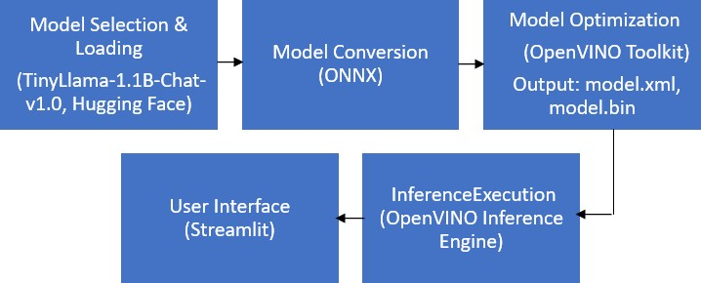
Process Flow

Slide 8
Architecture Diagram
Hardware
Intel AI Laptops (CPU)
Software
Operating System
Intel® OpenVINO™ toolkit
Model Selection and Optimization using OpenVINO
Inference and Fine Tuning
LLM Model
(Tiny Llama)
Model Conversion (IR Format)
Model Quantization
(NNCF)
Inference Engine (CPU)
Fine-Tuning Engine(CPU)
Application Layer (Gradio Interface)

Slide 9
Technology Stack
Hardware
Intel AI Laptops: High-performance laptops equipped with Intel CPUs.
Software and Toolkits
Operating System: The operating system installed on Intel AI Laptops ( Windows).
Intel® OpenVINO™ Toolkit: A toolkit for optimizing and deploying deep learning models on Intel hardware.
Python: A programming language commonly used for AI and machine learning development.
Model and Frameworks
TinyLlama/TinyLlama-1.1B-Chat-v1.0:refers to a specific version (v1.0) of the TinyLlama model designed for chatbot applications using natural language processing techniques.
PyTorch: An open-source machine learning framework used for developing and training the model.

Slide 10
Technology Stack(cont’d…..)
NLP Libraries
Transformers by Hugging Face
Data Handling
PyTorch DataLoader and Dataset
Inference API
Hugging Face Pipeline (Part of Transformers library)
Model Conversion and Optimization OpenVINO toolkit,NNCF(Neural Network Compression Framework)
User Interface
Gradio

Slide 11
Team Members and Contribution
Abin Sabu Philip (Team Leader): CPU Inference, Model Optimization and Quantization
Abhinand M. : User Interface Implementation, Project Report

Slide 12
Conclusion
In conclusion, leveraging Intel® AI Laptops with Intel® OpenVINO™ for GenAI and LLM inference on CPUs demonstrates efficient deployment and optimization without relying on GPUs. Fine-tuning LLM models with OpenVINO™ enhances performance and scalability, showcasing the adaptability of advanced AI applications on consumer-grade hardware. This approach underscores the feasibility of cost-effective, high-performance AI solutions that are portable and accessible across various computing environments.

